Slide 1

보너스
Matrix 분류와 적합한 Inverse 알고리즘
Bumhee Cho

Slide 2






Matrix의 성질로 분류해보자
양자역학, 동역학, ...
Real matrix
Complex matrix
Symmetric
Positive definite
Negative definite
Indefinite
Non-symmetric
Hermitian A = A*
Positive definite
...
Non-Hermitian
Cholesky decomposition
Diagonal pivoting method
물리적 현상
LDL decomposition
or
block symmetric diagonal
tridiagonal
block Hermitian diagonal
Gauss elimination
LU decomposition

Slide 3


Complex symmetric matrix
boundary integral equations
non-Hermitian matrix
definiteness?
Diagonal pivoting method
block symmetric diagonal
block Hermitian diagonal

Slide 4
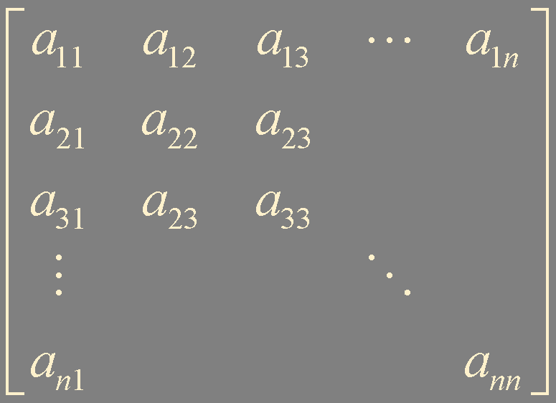
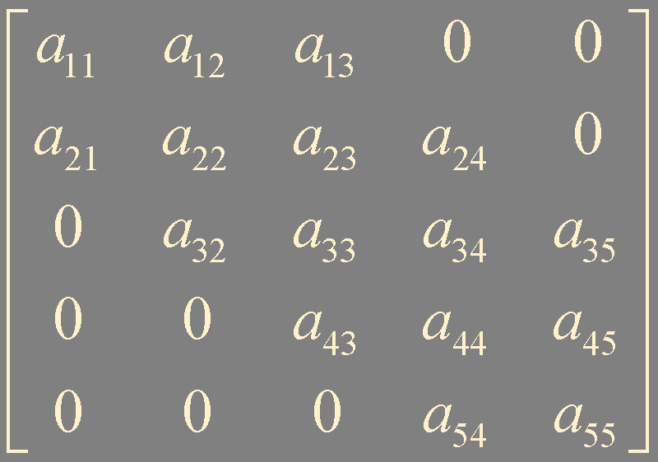
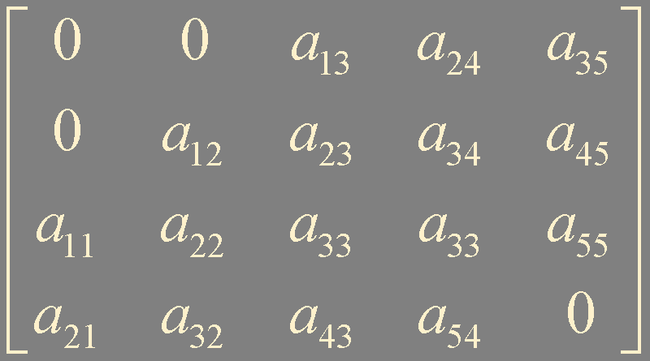
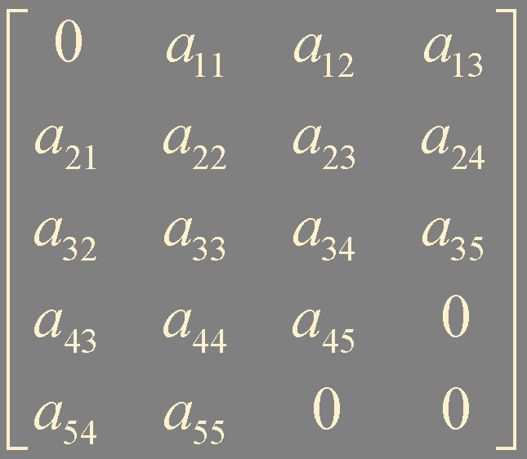
Matrix의 모양로 분류해보자
upper bandwidth = 2
Full matrix
Band matrix
저장용량 아끼기!
lower bandwidth = 1
upper bandwidth = lower bandwidth = 1
tridiagonal matrix
1D FDM

Slide 5
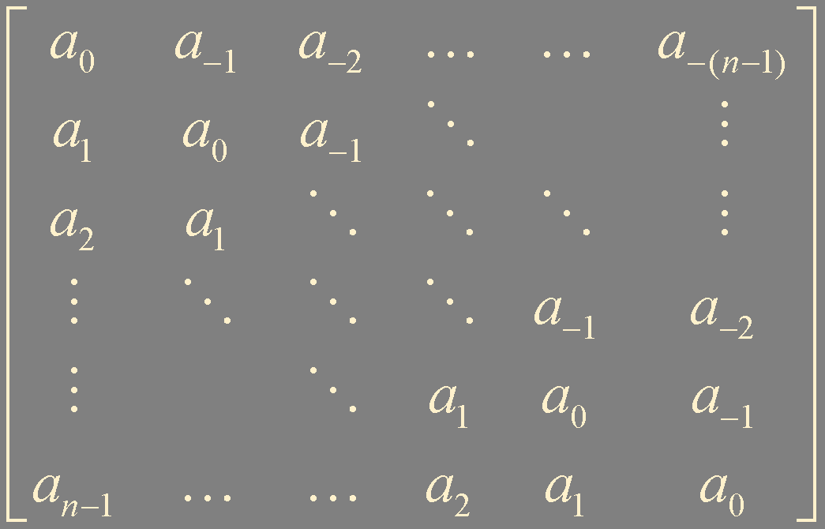
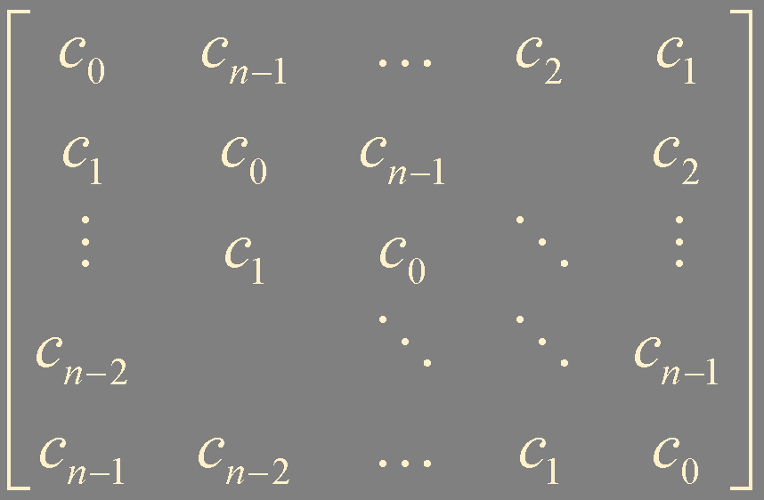
특별한 Matrix
Toeplitz matrix
Circulant matrix
digital image processing
signal processing
cryptography
…
Levinson-Durbin recursion
circular convolution theorem
~n²
discrete Fourier transform
Bareiss algorithm
~n²
fast Fourier transform
~n log(n)

Slide 6
Iterative Methods
Jacobi
Gauss-Seidel
Successive over-relaxation (SOR)
Conjugate Gradient (CG)
BiCG
BiCG-Stab
generalized minimal residual method (GMRES)

Slide 7


